Slide 1


Cypurr Sessions
The Holiday #CryptoParty Extravaganza
December 10th, 2017
Notes:
“La ingeniería de eq de fases comprende la aplicación del conocimiento fenomenológico del comportamiento de sistemas homogéneos y multifásicos, y su predicción mediante herramientas termodinámicas, con la finalidad de contribuir al desarrollo de procesos químicos. El diseño del equilibrio de fases es un nexo entre los requerimiento de un dado proceso y las actividades académicas de medición y modelado de datos experimentales.
[…] Esta disponibilidad (de simuladores computacionales) hace necesario estudiarla, con la finalidad de alcanzar un uso más fehaciente y efectivo de éstos, a través del desarrollo de criterios generales que faciliten la comprensión del potencial y limitaciones del proceso químico.”
Pereda, tesis doctoral, PLAPIQUI/UNS 2003, pp 4.1.

Slide 2
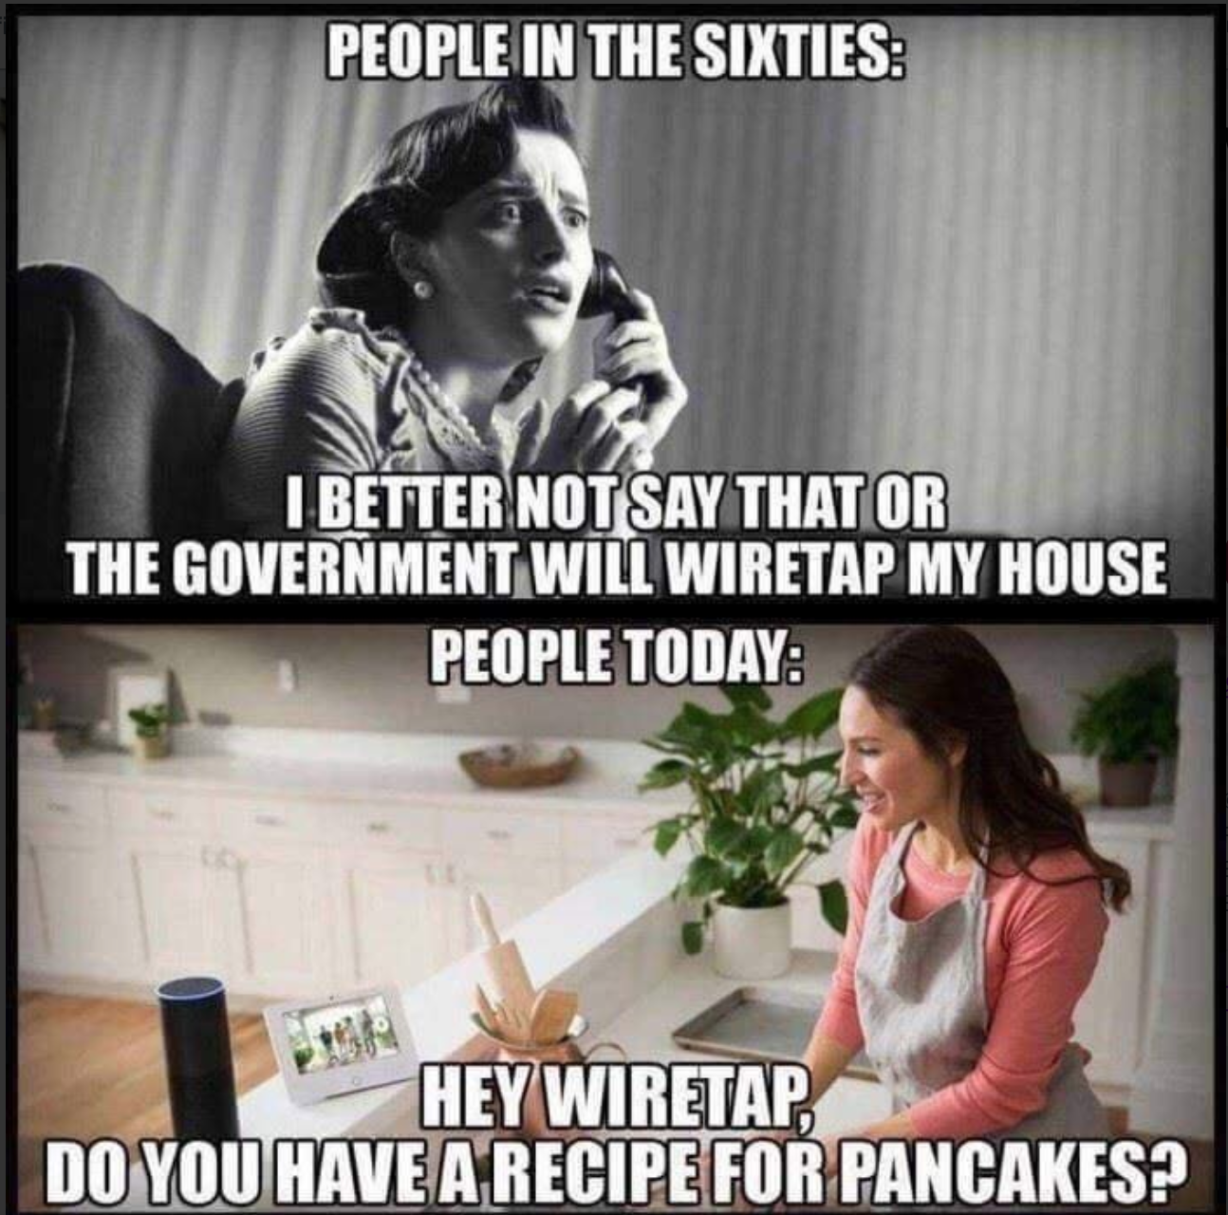
WELCOME!

Slide 3
Outline
Introduction
Rules n’ Such
Current Events
Mini Workshops
5 Stocking Stuffer Apps
Blues Skies: Securing the Cloud
Crypto Convos 4 the Holidays
Thank You/Resources
Notes:
Ability concerns contact
Assisting with needs
Breaks
“Can everyone see [me/ the board/ the screen/ the main point of focus]?”
“Can everyone hear me at this volume? Am I speaking at a good pace?”
New words/phrases

Slide 4
Who are we? Who are you?
We are the…
The Cypurr Collective: A group of folks that organize cybersecurity workshops and socials, looking to spread knowledge and talk about privacy rights!
...and you are?
Name
Pronouns (i.e. he/him, she/her, they/them, ze/zer, etc)
In a few words, what brings you here today?

Slide 5

A few rules for this workshop …
Share the space!
Step Up Step Back: Ask a question, give a comment, leave room for others to speak
Stack!
Raise your hand and we will put you on the speaking queue
Saf(er) Space
We DO NOT tolerate language or behavior purposefully meant to demean or harm folks based on their identities
No one should be forced to discuss their own experience/threat model/situation
What’s said in the room, stays in the room
Consent: Ask before helping someone out, before taking their device
Photo/Video- No photo/video without asking!
Bonus Rule: Try not to invalidate experiences!

Slide 6
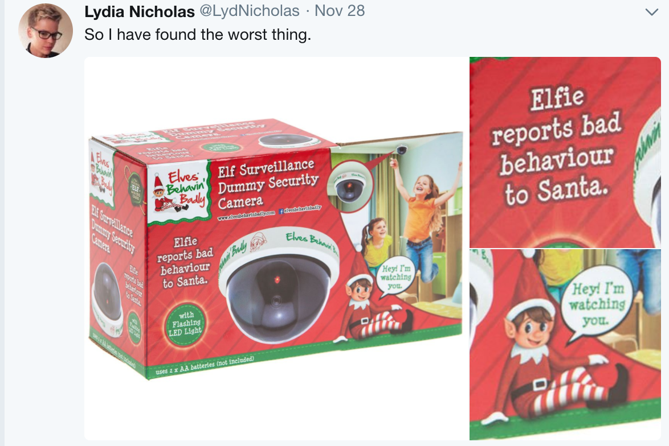
Current Events!

Slide 7

WHAT’S ON YOUR MIND?

Slide 8
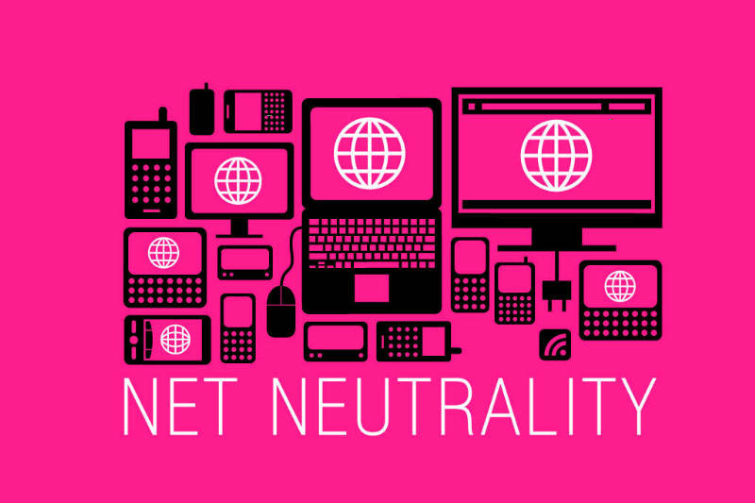
Story: I Want My NetNeutrality!
FCC Net Neutrality Vote Coming Up This Week
December 14th

Slide 9
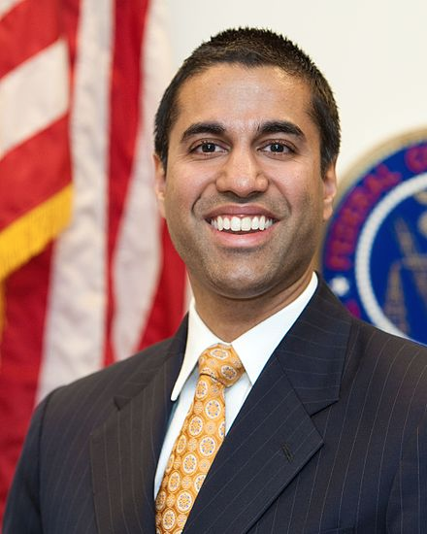
The Story?
Net Neutrality is under attack
Net Neutrality rules established by the FCC under the Obama administration (alongside years of grassroots activism) keep ISPs from controlling how and what info is delivered to users
With the prediction that FCC members will vote by party lines, analyst say the December 14th vote will reverse these rules, 3-2

Slide 10
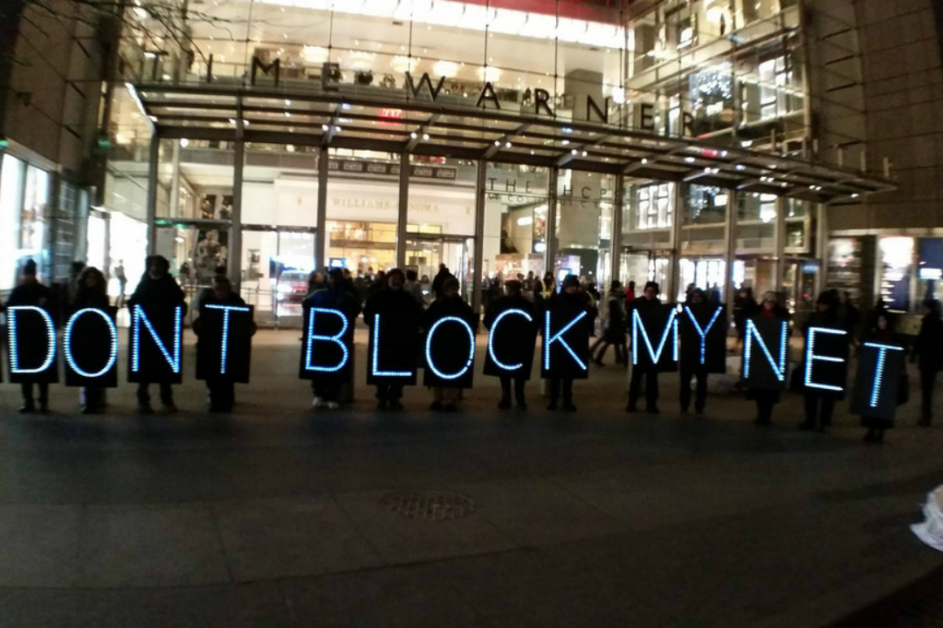
The Threat?
ISP have more control over distribution of content
Censorship
Higher Prices
Pay to Play
“...the rules prohibit Internet providers from blocking, throttling, and paid prioritization—"fast lanes" for sites that pay, and slow lanes for everyone else.”

Slide 11
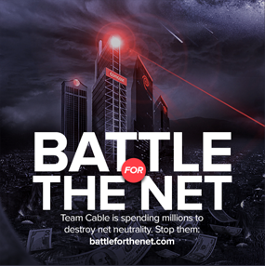
What To Do?
Check out www.battleforthenet.com/ for more info!
Comment on FCC.gov!
Teach yourself, teach a friend!

Slide 12
STRETCH BREAK

Slide 13
Mini Workshops!
5 Crypto Stocking Stuffers
Blue Skies: Securing the Cloud

Slide 14

Cybersecurity for the Soul
(for the Holidays and Beyond!)
Cyber
Security

Slide 15
What are some infosec changes you wanna make you in your own life for the upcoming year? Think small, what can you do in the first month or two?
Are there challenges in reaching your goal? How do you foresee overcoming them?

Slide 16
Thinking beyond yourself to your community what are some ways you can improve infosec in the first couple months of the new year?
Are there challenges in reaching your goal? How do you foresee overcoming them?

Slide 17
Thank You and Resources
CyPurr Collective on Facebook for Future events!
Sign up to our email list too, we won’t spam ya!
Current Events Resources
BattlefortheNet.com

Slide 18
Thank You and Resources
Further Resources
NYC CryptoParty Meetup/CryptoParty Harlem (Meetup)
HackBlossom (Hackblossom.org)
Tactical Tech Collective-
Holistic Security,
MyShadow
Data Detox
EFF- Surveillance Self Defense (ssd.eff.org)
Freedom of the Press Foundation (Freedom.press)
AnarchoTech Collective- Ridgewood, NYC

Slide 19

See you next time!

